Slide 1
# 28687 - Campaign for comparing TCCON to complementary instruments for S5P validation (TCCONcomp)
BELGISCH INSTITUUT VOOR RUIMTE-AERONOMIE INSTITUT D’AERONOMIE SPATIALE DE BELGIQUE BELGIAN INSTITUTE OF SPACE AERONOMY BELGISCH INSTITUUT VOOR RUIMTE-AERONOMIE INSTITUT D’AERONOMIE SPATIALE DE BELGIQUE BELGIAN INSTITUTE OF SPACE AERONOMY BELGISCH INSTITUUT VOOR RUIMTE-AERONOMIE INSTITUT D’AERONOMIE SPAT-
M. De Mazière, M. K. Sha, C. Hermans Belgian Institute for Space Aeronomy (BIRA-IASB)
J. Notholt, T. Warneke University of Bremen (IUP - Bremen)
F. Hase, T. Blumenstock Karlsruhe Institute of Technology (KIT)
D. Weidmann Rutherford Appleton Laboratory (RAL )
D. Griffith, N. Jones University of Wollongong (UoW)
H. Chen University of Groningen (RUG)
R. Kivi, Pauli Heikkinen Finnish Meteorological Institute (FMI)
Current plans taking into account budget limitations
BELGISCH INSTITUUT VOOR RUIMTE-AERONOMIE INSTITUT D’AERONOMIE SPATIALE DE BELGIQUE BELGIAN INSTITUTE OF SPACE AERONOMY BELGISCH INSTITUUT VOOR RUIMTE-AERONOMIE INSTITUT D’AERONOMIE SPATIALE DE BELGIQUE BELGIAN INSTITUTE OF SPACE AERONOMY BELGISCH INSTITUUT VOOR RUIMTE-AERONOMIE INSTITUT D’AERONOMIE SPAT-
M. De Mazière S5PVT Workshop ESTEC, 28/9-1/10 2015

Slide 2
Rationale & Objectives
Rationale:
TCCON instruments are very expensive and not mobile
Filling remaining gaps in existing TCCON network is too costly, requires significant infrastructure and suffers from low flexibility
Goals:
verify performances of potential alternative instruments during a dedicated campaign
Use campaign data for validation of S5P

Slide 3
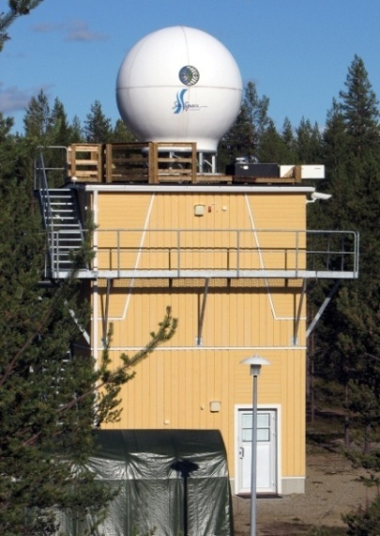
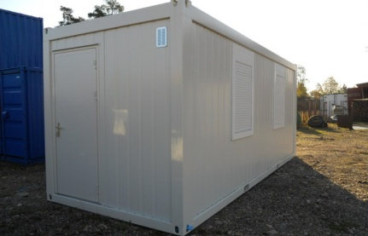
Campaign setup (1/2)
Location: TCCON station Sodankyla – adding container for housing campaign instruments
Hole in the roof: 20 cm Tracker; 10 cm cables
Hole in the wall 10 cm
Hole in the wall 10 cm
Window, 0.82*1.1m
Window, 0.82*1.1m
Cables inlet: power cable, ethernet cable
Tracker
IR Cube
EM27/SUN
QCLHR
Vertex 70
Ilmalämpöpumppu
Door, 0.86*2m
Dimensions 9 m long, 3.25 m wide, 2.6 m high
TCCON Bruker 125HR (FMI) (XCH4, XCO, XCO2)
Bruker EM27/SUN (KIT) (XCH4, XCO2)
Bruker Vertex 70 or 80 (BIRA & IUP) (XCH4 , XCO, XCO2)
IR cube (UoW) (XCH4, XCO, XCO2 )
Quantum cascade later heterodyne radiometer (RAL) (CH4, CO, CO2)
Aircore (CH4, CO, CO2 vertical profiles)

Slide 4
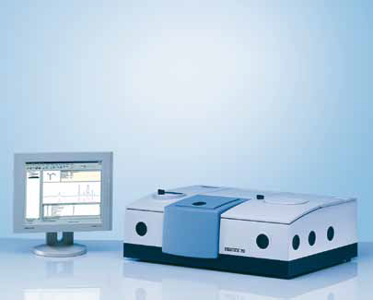
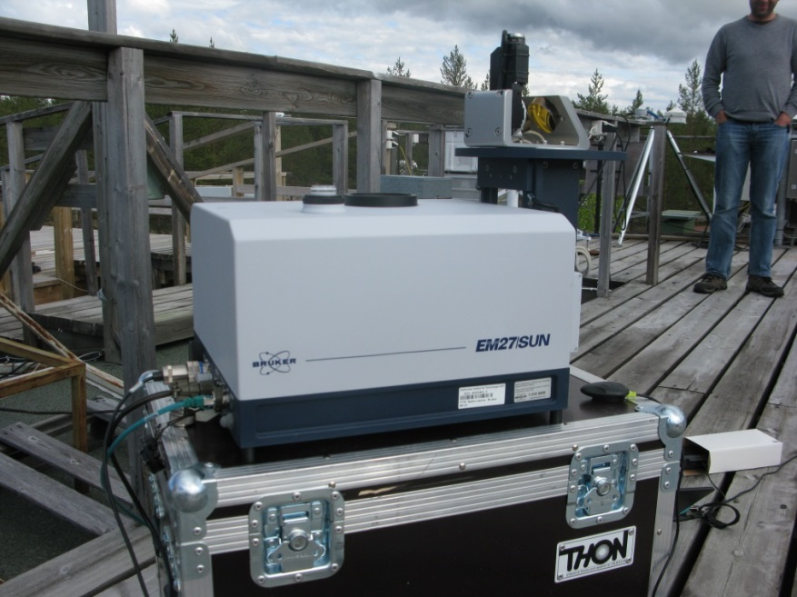
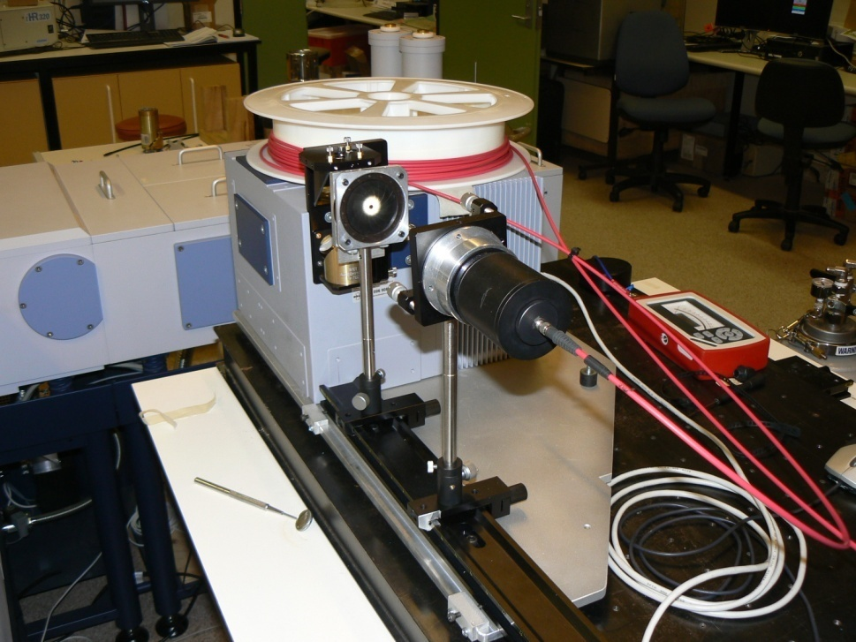
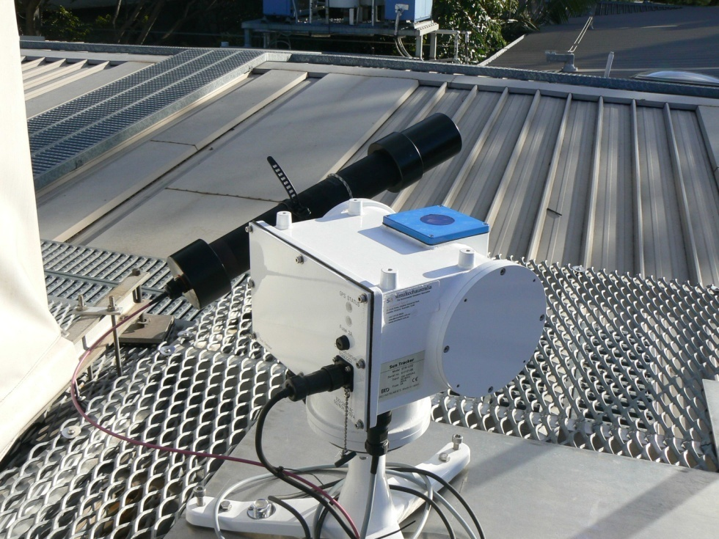
Bruker Vertex 70 or 80
EM27/SUN
IR cube

Slide 5
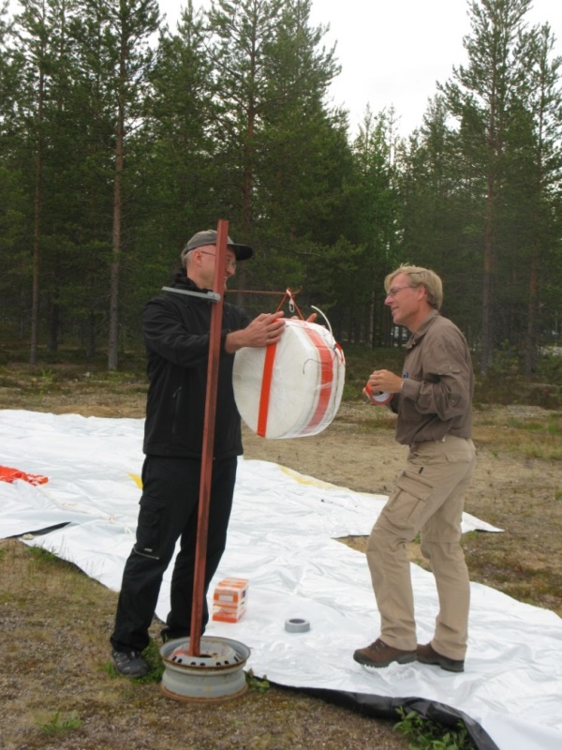
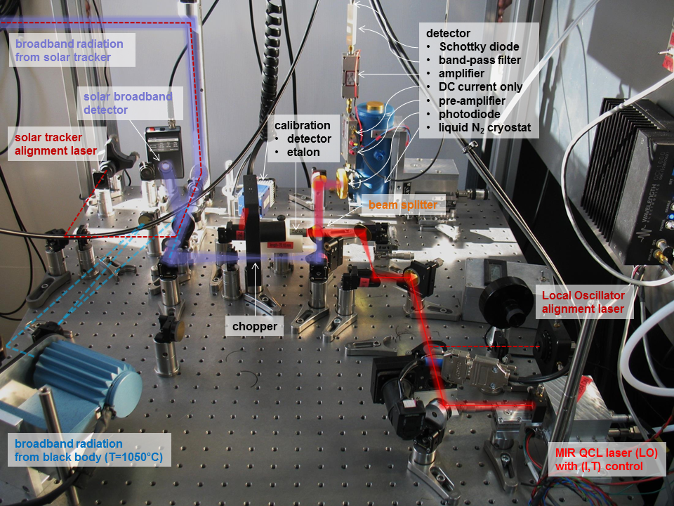
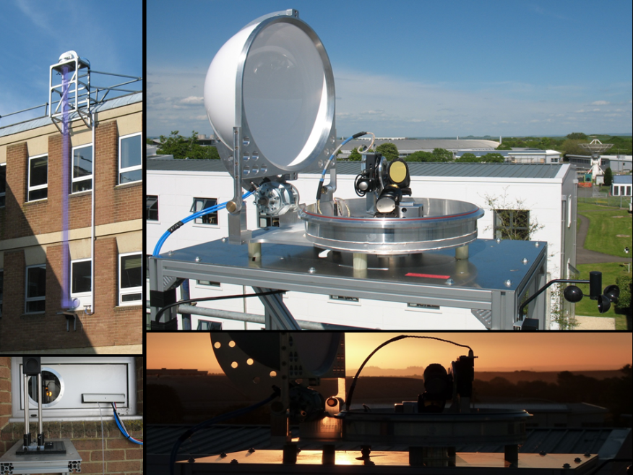
Aircore
QCLHR

Slide 6
Campaign setup (2/2)
Duration: ∼ 1 year (March – October or November 2016)
Workplan:
Preparation of participating instruments & aircore design (all)
Preparation of campaign (planning, intercomparison and data protocol, BIRA) and site (FMI)
Set-up and tests of the instruments on site (all)
Simultaneous TCCON and RS observations and regular aircore flights (all)
Data analyses (all) and blind intercomparisons (BIRA)
Comparisons with S5P data (BIRA and all)
Conclusions: intercomparison report and publication(s) (BIRA & all)

Slide 7
Funding situation
No Belgian national funding for this activity
Germany: No national funding
UK: no national funding up to now
Netherlands: No national funding for this activity
Australia ?
Finland: FMI will build a container for the campaign, and FMI will support the campaign
ESA is willing to support intercomparison protocol, not the S5P validation activities

Slide 8
Backup slides

Slide 9
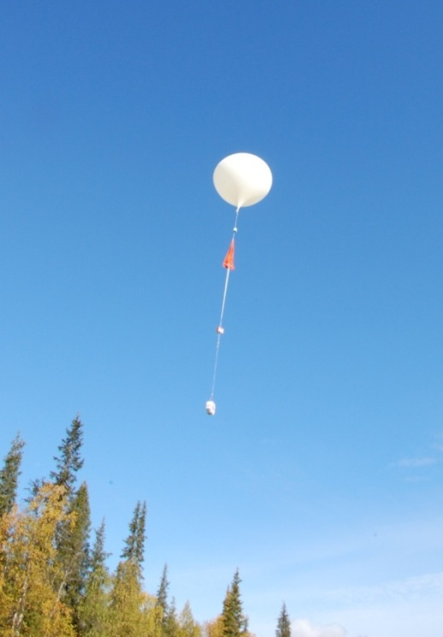
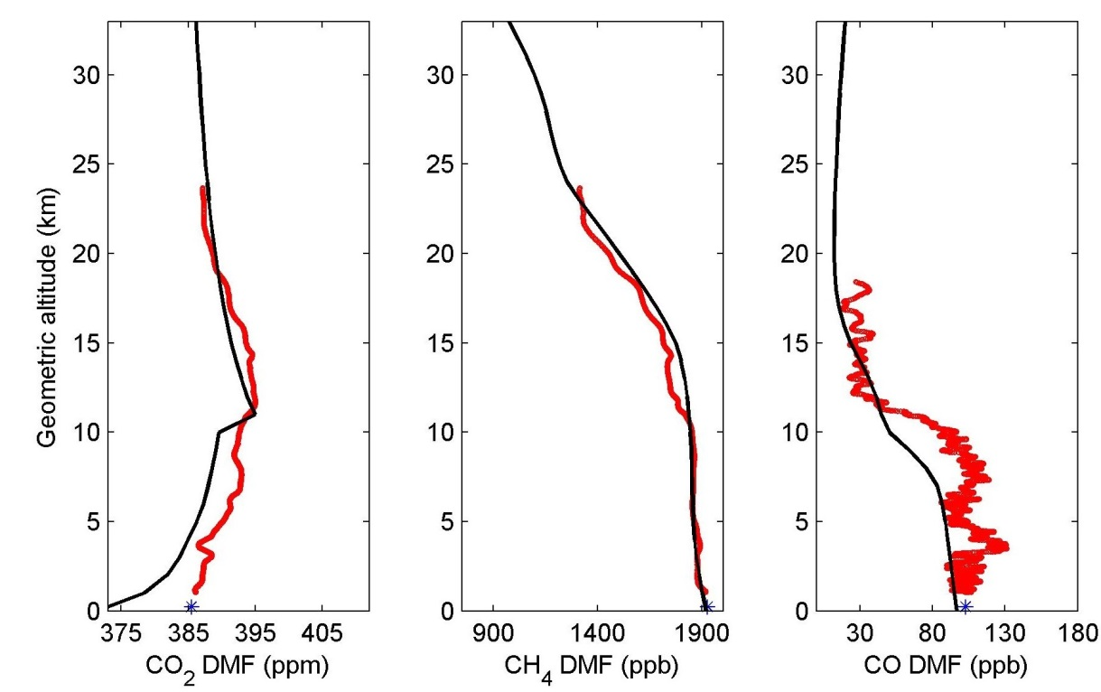
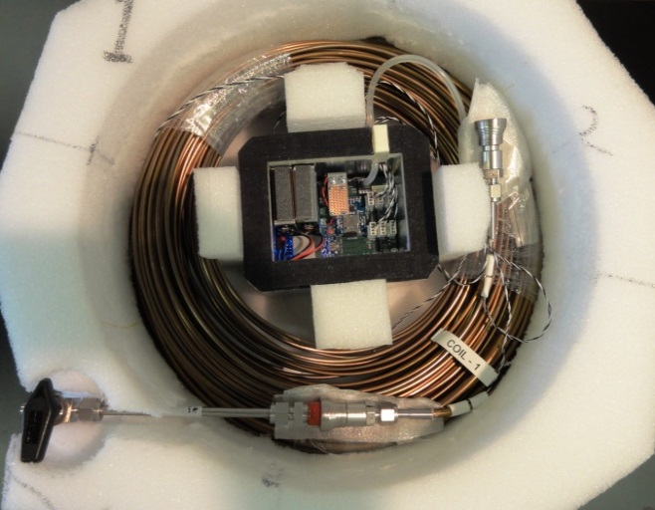
AirCore at Sodankylä
At Sodankylä we have performed AirCore observations since September 2013. The measurements cover all seasons. An example of AirCore profiles of CO₂, CH₄ and CO is shown above (from September 3, 2013). AirCore profiles are in red and the TCCON a priori profiles in black. Blue star corresponds to tower measurements at Sodankylä.
The AirCore system at Sodankylä is built as a stainless steel tubing of about 100 m long, consisting of ~40 m of ¼” and ~60 m of 1/8” tube. This configuration makes it possible to measure profiles with vertical resolution of 5 mb in the stratosphere and 15 mb in the troposphere.
The system also involves a data acquisition unit to store pressure and temperature during an AirCore flight, a RS92 radiosonde and a positioning device.
AirCore is lifted to the stratosphere using a meteorological balloon. After the landing we have analysed the sample using the Picarro G2401 gas analyser.
AirCore instrument with an open cover
AirCore team at FMI/RUG: R. Kivi, H.Chen, M. de Vries, J. Hatakka, P. Heikkinen, B. Kers, T. Laurila

Slide 10
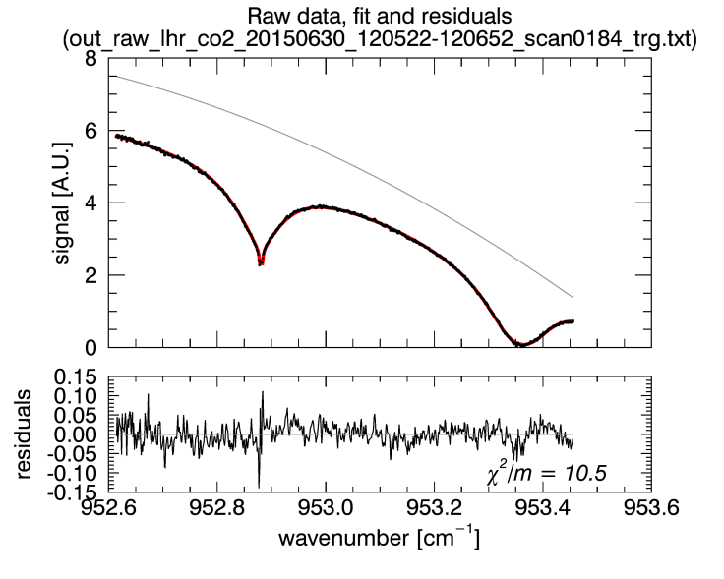
QCLHR spectra

