Slide 1
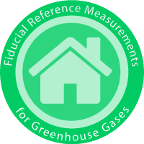
Fiducial Reference Measurements for Greenhouse Gases (FRM4GHG)

Slide 2
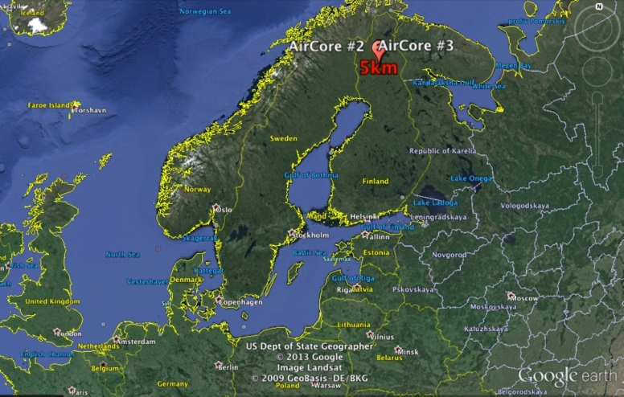
Project objectives & implementation
Assess characteristics of instruments in their capability to provide precise GHG column measurements, and that are cheaper and more mobile than the standard TCCON instrument
Perform an intercomparison of simultaneously measured total column concentrations of a few GHG (CO₂, CH₄, CO) using several different infrared spectrometric instruments colocated at a TCCON site, covering all seasons
Chosen TCCON site = Sodankyla
@ 67°N
In-situ vertical profiles of GHG are
provided by regular AirCore launches
Notes:
Rationale -> see F. Hase yesterday
Into about small spectrometers yesterday

Slide 3
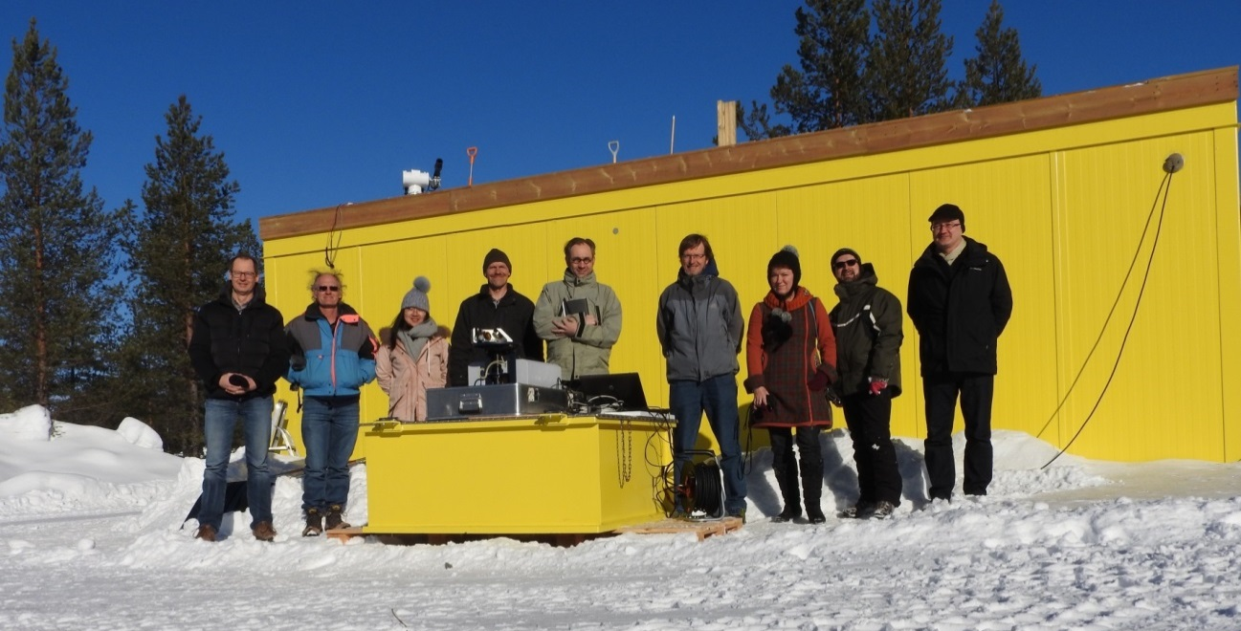
Project partners & funding
J. Notholt, C. Petri (University of Bremen, IUP)
M. De Mazière, C. Hermans, F. Scolas, M. K. Sha (Royal Belgian Institute for Space Aeronomy)
R. Kivi, P. Heikkinen, Finnish Meteorological Institute
T. Blumenstock, F. Hase, Q. Tu (Karlsruhe Institute of Technology)
N. Jones, D. Griffith (U. Wollongong)
D. Weidmann, A. Hoffmann, M. Huebner (Rutherford Appleton Lab)
H. Chen, Joram Hooghiem (University of Groningen)
Project duration: August 2016 → end Jan. 2018
Funded by ESA, Technical Officer : A. Dehn
assisted by P. Castracane
Notes:
Container acquired by FMI
Australians not wearinng shorts !

Slide 4
Project timeline

Slide 5
Instruments overview
Institute | Instrument | Spectral range (cm⁻¹) | Resolution (max) | Species observed
FMI | Bruker 125HR | 1800-15000 | 0.004 cm⁻¹ | CO2, CH4, CO, H2O, O2
Uni Bremen BIRA | Bruker Vertex70 | 2500-15000 | 0.16 cm⁻¹ | CO2, CH4, CO, H2O, O2
KIT | Bruker EM27/SUN Dual channel option | 4000-9000 | 0.5 cm⁻¹ | CO2, CH4, CO, H2O, O2
Uni Wollongong | Bruker IR cube | 4500-15000 | 0.5 cm⁻¹ | CO2, CH4, H2O, O2
RAL | Laser Heterodyne Radiometer | 950/1280 | 0.002 and 0.02 cm⁻¹ | CO2, H2O
Uni Groningen | AirCore balloon | In-situ sampling | 13.4 mbar (AmbP>232 mbar) 3.9 mbar (AmbP<232 mbar) | CO2, CH4, CO
Notes:
See extended spectral ranges and different spectral resolutions
Vertex 70 – cf. Vertex 80 here in Paris (NH3 talk on Tuesdayy).
-> Mores species than only TCCON Gases cf. InSb detecor present
Idem for RAL and IR cube ? !

Slide 6
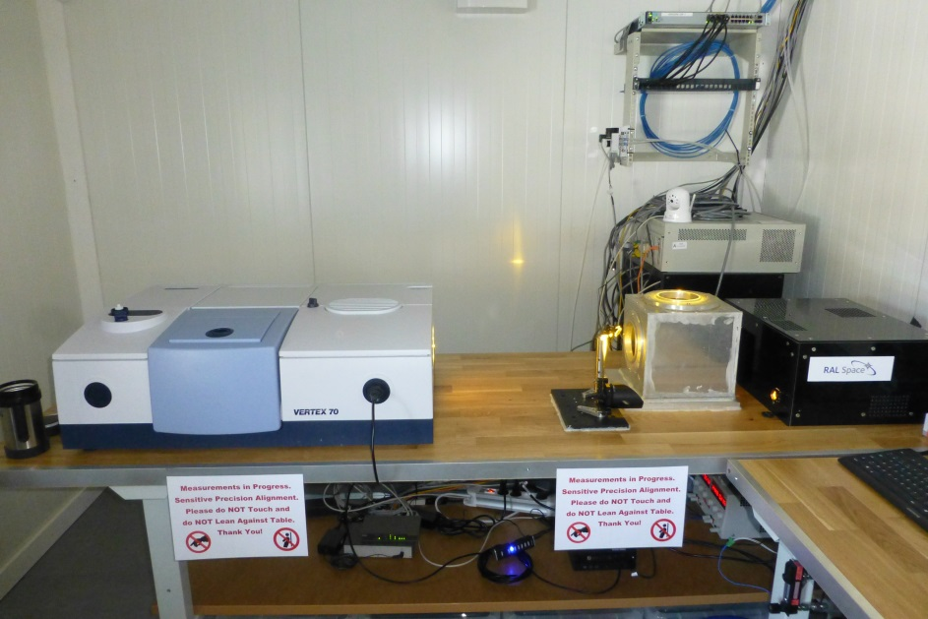
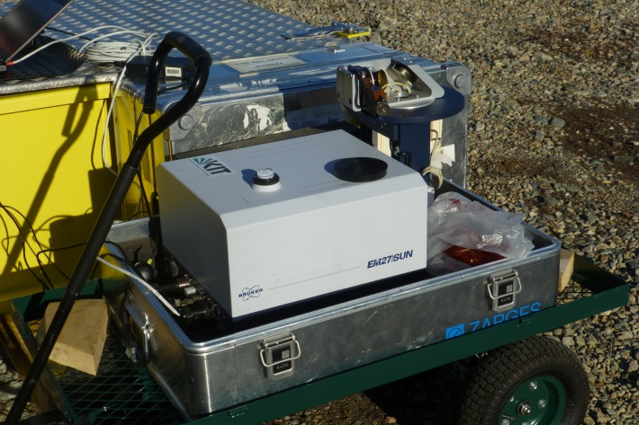
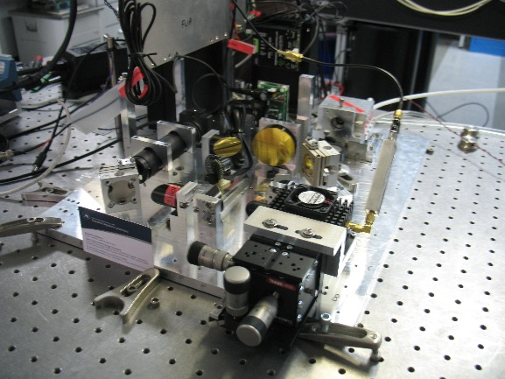
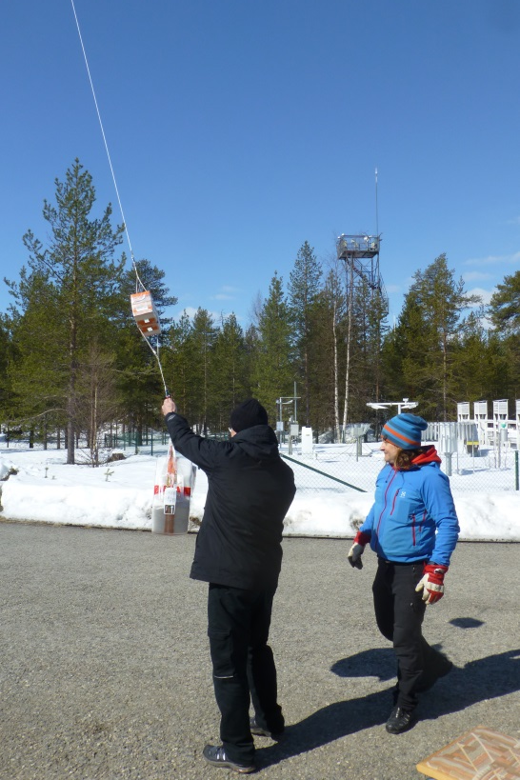
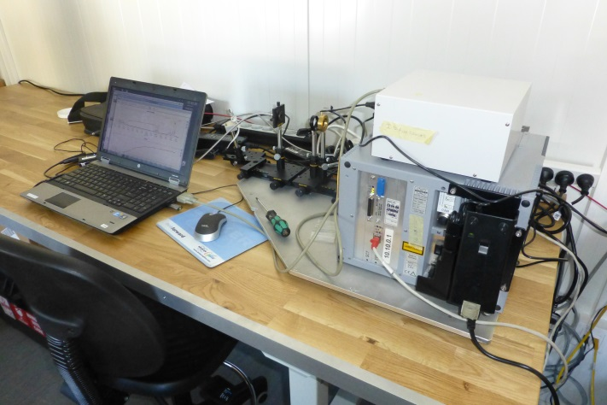
Vertex 70
AirCore launch
EM27/SUN w/ suntracker
LHR optical breadboard
IR cube
Notes:
Vertex 70 – cf. Vertex 80 here in Paris (NH3 talk on Tuesday).
-> Mores species than only TCCON Gases cf. InSb detecor present
Idem for RAL and IR cube ? !

Slide 7
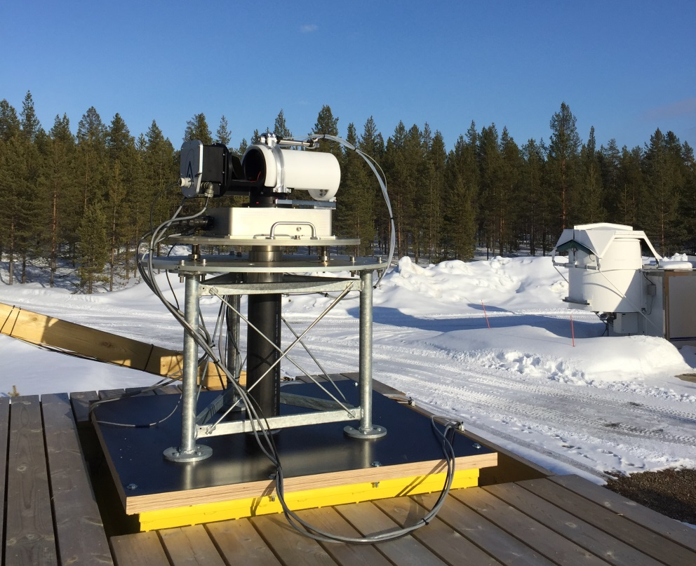
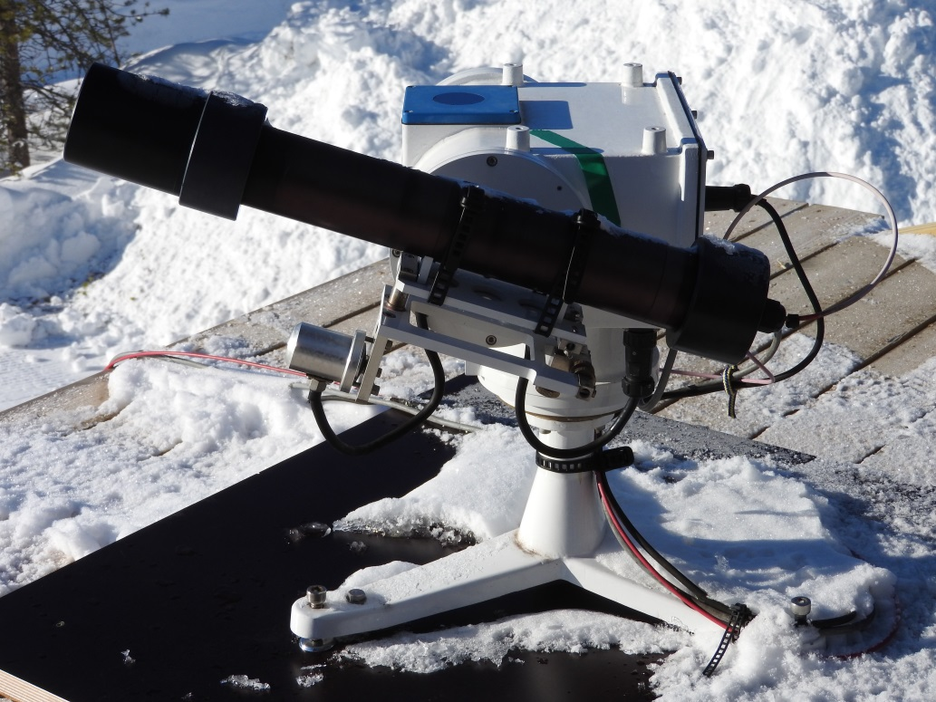
Suntrackers
Fiber-coupled to IRcube
BIRA suntracker- coupled to Vertex and LHR

Slide 8
Measurement & blind intercomparison strategies
All instruments are operated ‘as usual’ and data are analysed ‘as usual’ ; common P/T surface data and vertical profiles are used
All teams deliver ‘incognito’
For all measurement days and good spectra: column values for CO, CH4, CO2, H2O and O2; XCO, XCH4;
(RAL provides only CO2 & H2O;
IR‐cube doesn’t measure CO.)
Instrument alignment measurements

Slide 9
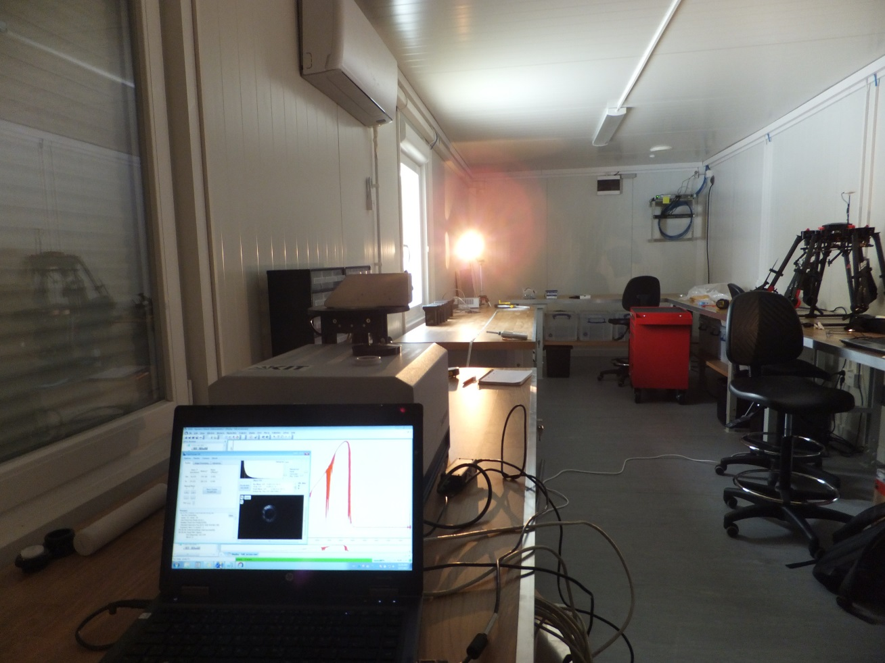
Measurement & blind intercomparison strategies
TCCON and Vertex 70 ILS parameters are determined by HCl cell measurements.
KIT and UoW retrieve ILS from water vapour band 7000‐7500 cm‐1 in open air, not from a cell.
Linefit is used to analyze the ILS parameters (ME and Phase error) for each instrument
RAL has gas cell measurement only before instrument was shipped to Sodankyla and will do cell measurements again after the Sodankyla campaign; it will provide FW model spectra convolved with ILS measured electronically at start of campaign – to be compared with actual observed spectra.

Slide 10
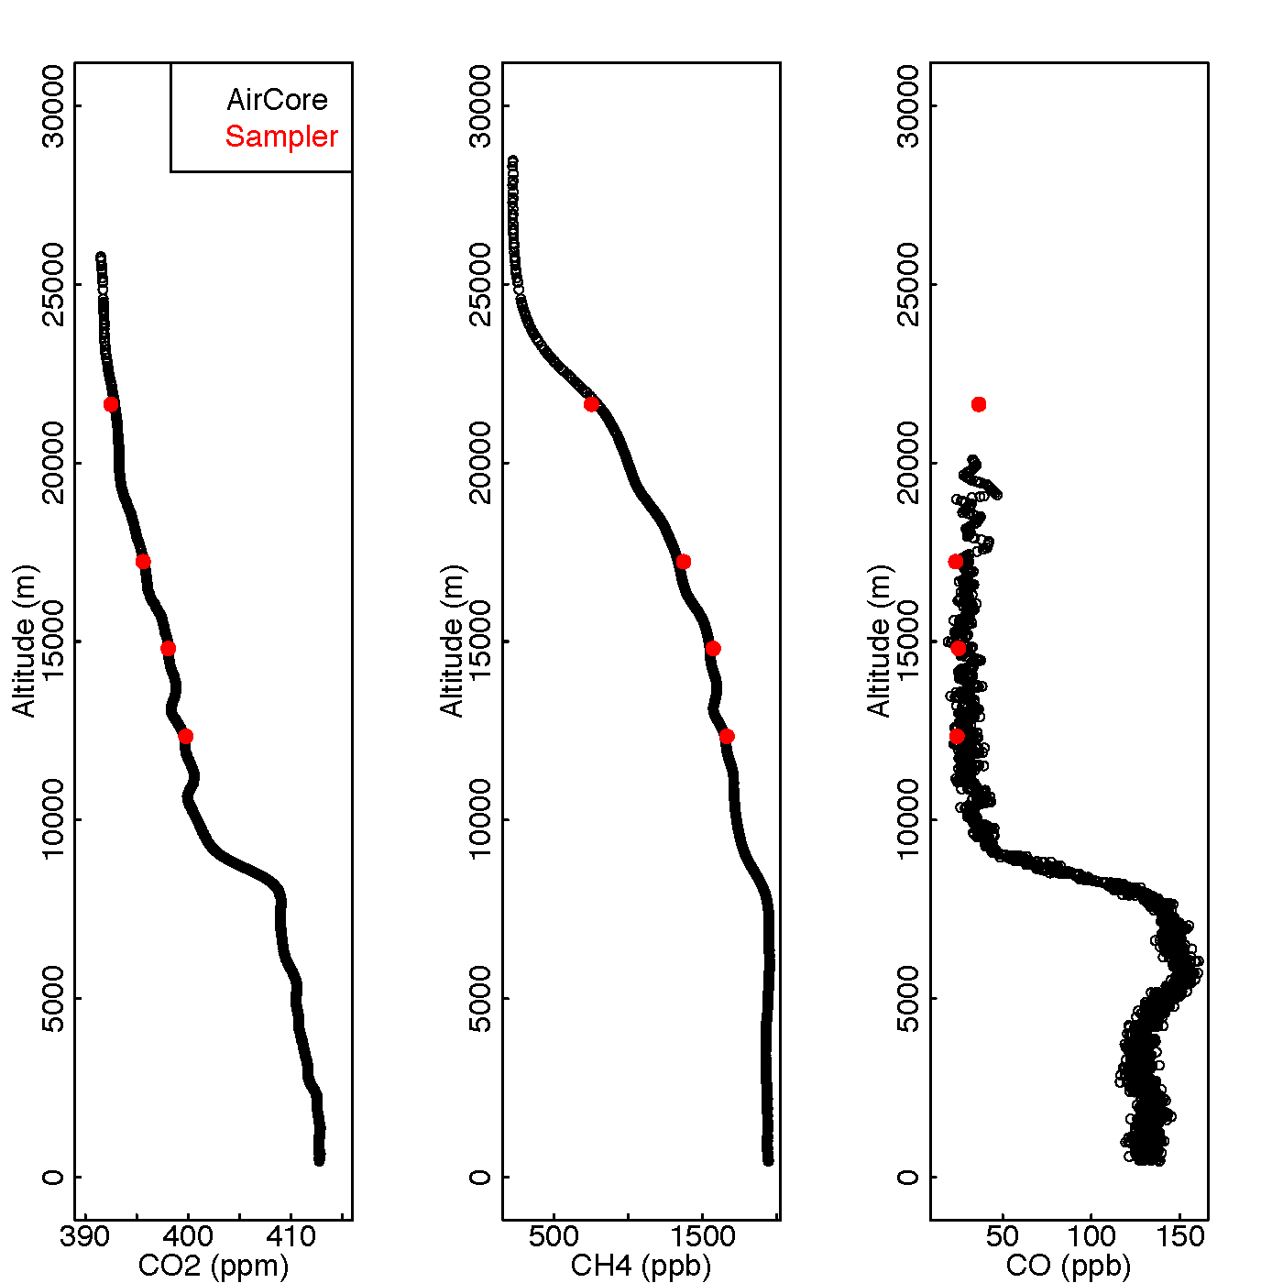
AirCore profiles
Validation of AirCore against sampler meas.
- Independent 4 air samples collected
- Vertical resolutions 0.5-1.3 km at 12 - 22 km
AirCore (planned) flights
Fight no. | Month | Date
1 | April | 20170421
2 | April | 20170424
3 | April | 20170426
4 | May | 20170515
5 | June | planned
6 | July | planned
7 | August | planned
8 | September | planned
Notes:
Optional FRM4GHG – WP on the development of a platform for AirCore launch and controlled descent -→ see EU H2020 proposal ‘URSAC’

Slide 11
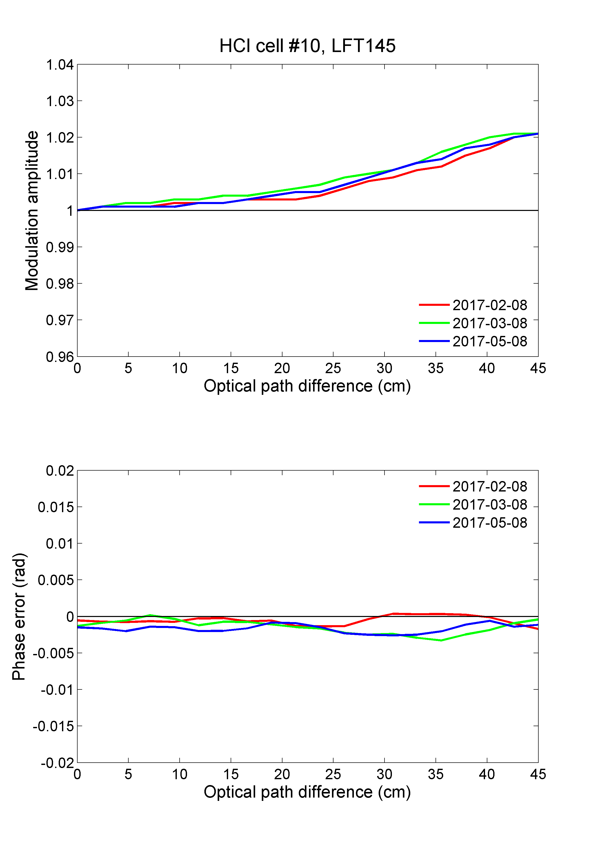
Current status of the instruments
TCCON Bruker 125HR
2%
< 0.005rad

Slide 12
Current status of the instruments
Vertex 70
22/4/2017
2%
Stable since the instrument left Bremen / Brussels !
- 46.8 mrad
- 48 mrad

Slide 13
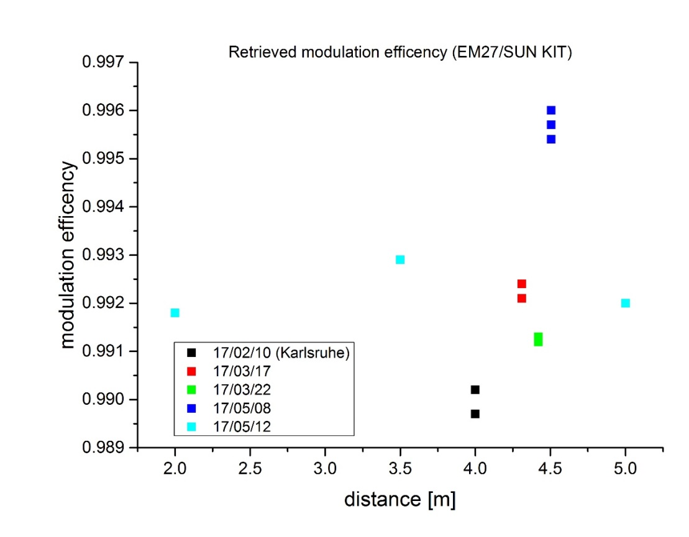
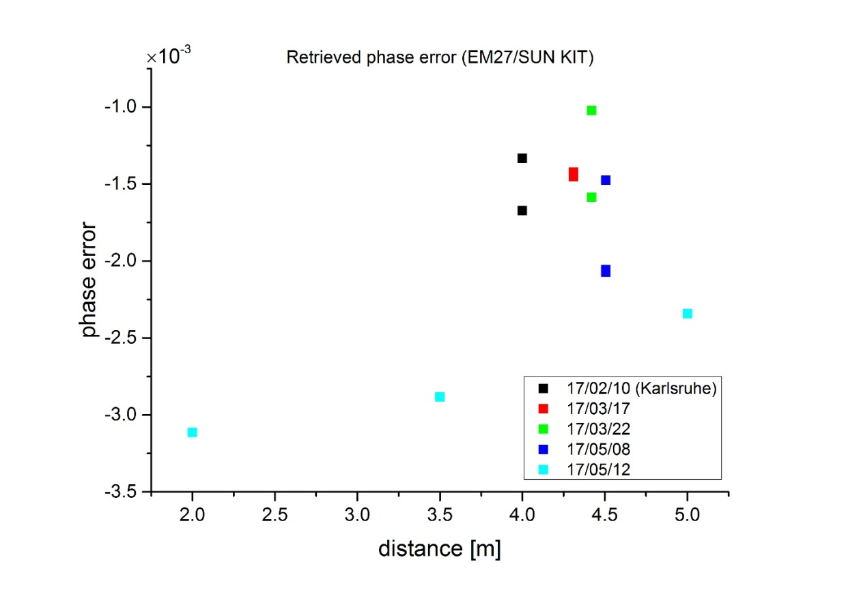
Current status of the instruments
EM27/SUN
0.8%
3.5x10⁻³ rad

Slide 14
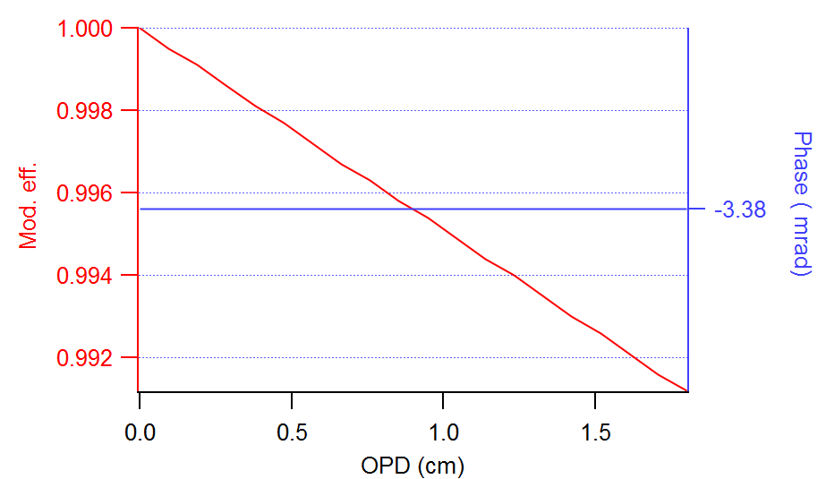
Current status of the instruments
IR cube

Slide 15
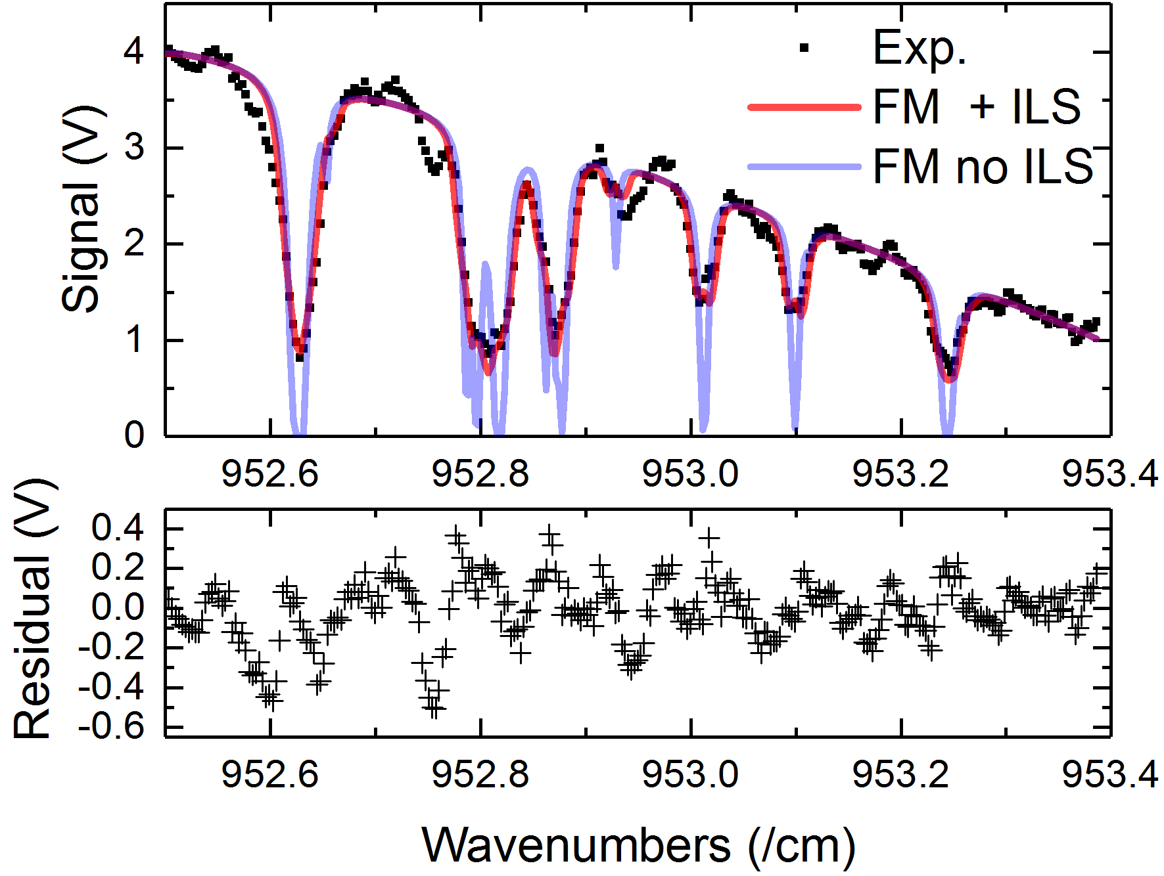
Current status of the instruments
LHR
- ILS defined by electronic filter transmission
- Measured using an RF generator
- Application of ILS to the forward transmission model (FM)
- 20 mbar of Ethane , 10 cm cell
- Note the lack of spectroscopic data (taken from HITRAN2012)

Slide 16
Current status of the observations

Slide 17
Next steps
End of June: ‘blind’ delivery to referee
→ first intercomparisons
possibly decision to change some measurement and/or analysis settings
E.g., agreement on common linelist
Then start of ‘open’ intercomparison phase
until end October
Final intercomparisons
analysis of results
Conclusions about (instrument + retrieval) behaviour

Slide 18
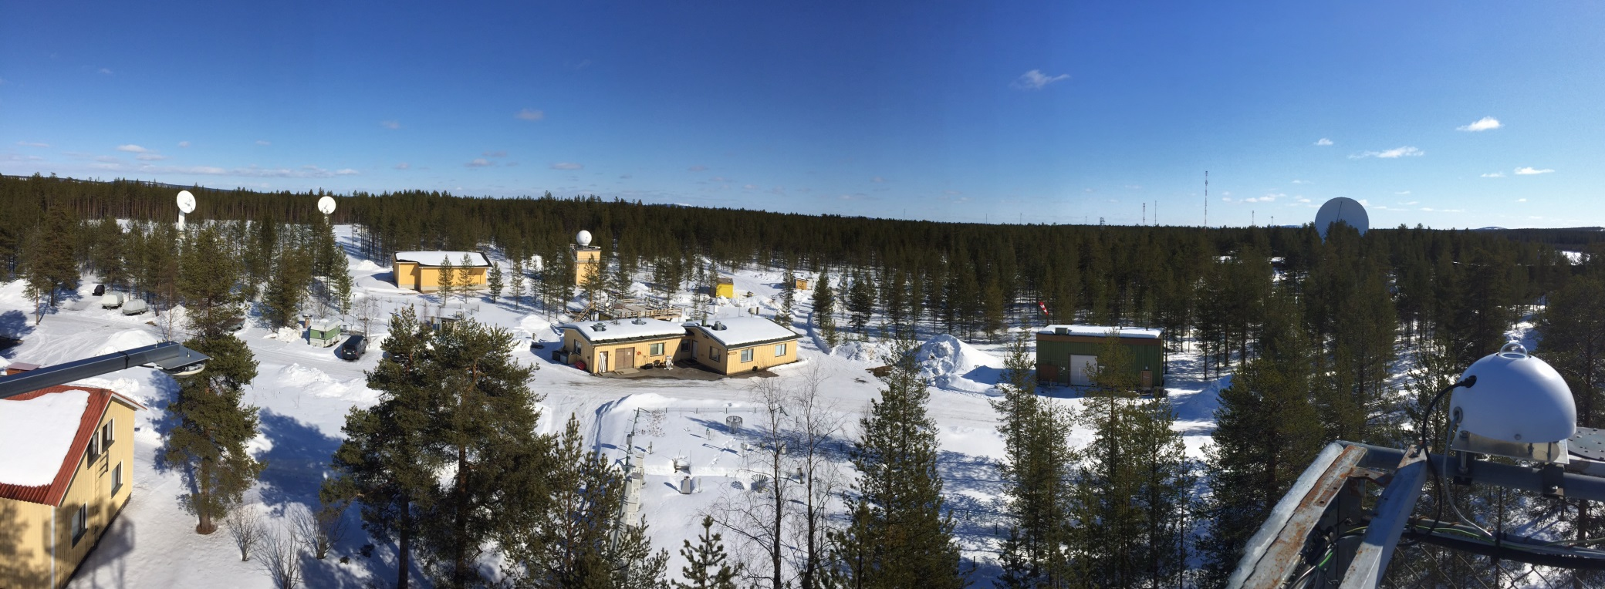
Access to information, data and results
http://frm4ghg.aeronomie.be
Results (for now for internal use only)
Outreach (will contain some results in the future)
Pictures
Campaign blog
Follow us on twitter: #frm4ghg
Thanks

